Slide 1
Communicating
21/02/2024
Year 7 Science

Slide 2
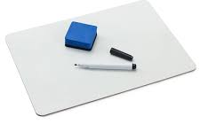
Review
What is the safe way to smell chemicals?
When should we use safety glasses?
What should you do if you spill something?
Where is the gas shut off?
Draw a test tube (as a scientific diagram).

Slide 3
Learning Intentions
Communicate ideas, findings and solutions to problems using scientific language and representations

Slide 4
Success criteria
Work together to solve problems
Record information in tables
Explain your reasoning to others

Slide 5

Communication

Slide 6
Lost in the Outback

Slide 7
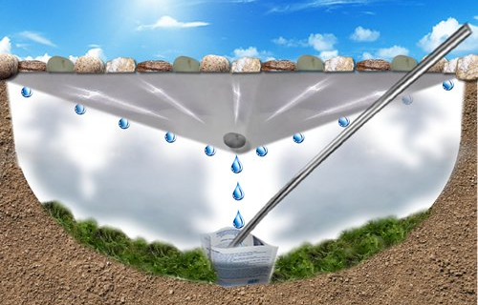
Build a Solar Still

Slide 8
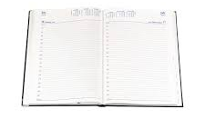
Diaries
Homework sheet – laboratory equipment
Due Friday 9 Feb

Slide 9
Success criteria
Work together to solve problems
Record information in tables
Explain your reasoning to others

